Slide 1

Netflix
Data ANALYSIS
Fainal Project By NTI

Slide 2


Our Team
Jomana Soliman Zainab Mohamed
Randa Fawzy Malak Abdelrazak
Farah Hamed
Basmala Mohamed

Slide 3
Introduction
Our project focuses on analyzing Netflix content data to discover
meaningful patterns and insights. We explore the distribution of movies
and TV shows, the countries producing content, audience ratings,
release years, and changes in Netflix's content library over time.
The project follows the complete data analysis process, starting with
the raw dataset and continuing through data cleaning, data preparation
, data querying, analysis, visualization, and interpretation.
Different tools were used throughout the project, including Excel
for data cleaning and preparation, SQL for querying and analyzing
structured data, Python for data analysis and exploration, and Power BI
and Tableau for creating interactive visualizations and dashboards.

Slide 4

Project Overview
The project follows a complete data analysis workflow :
Raw Data
Data Cleaning
Data Preparation
Data Analysis
Data Visualization
Key Insights
Recommendations
The workflow allows us to move from raw and unorganized data to meaningful information that can be easily understood and used for decision-making.

Slide 5

Project Objectives
The main objectives of this project are:
  Understand and explore
the Netflix dataset.
  Clean and prepare the data
for analysis.
  Analyze Movies and TV Shows.
  Examine content distribution
across countries.
  Use Python for data exploration and analysis.
  Create interactive dashboards using Power BI.
  Use Tableau for additional
data visualization.
  Analyze content ratings and categories.
  Study content distribution
across release years.
  Use SQL to extract and analyze data efficiently.
  Identify important patterns
and trends.
  Translate analytical findings
into useful recommendations.

Slide 6
Dataset
The dataset contains information about Netflix Movies and TV Shows.
Main Dataset Columns
Column Description
  show_id Unique ID for each title
  type Movie or TV Show
  title Name of the content
  director Director of the content
  cast Actors and actresses
  country Country of production
  date_added Date the content was added
  release_year Original release year
  rating Content rating
  duration Movie duration or number of seasons
  listed_in Genre / category
  description Short description of the content

Slide 7

DATA CLEANING & PREPARATION — EXCEL
Excel was used as an important step for inspecting and preparing the Netflix dataset before performing deeper analysis.
Main Tasks :
  Inspecting the dataset structure.
  Identifying missing values.
  Checking for duplicate records.
  Standardizing data values and formats.
  Checking data types.
  Organizing the dataset.
  Preparing a clean and consistent dataset
  for analysis.
Goal :
  To make sure that the data is clean, organized, and suitable for further analysis using SQL, Python, Power BI,
and Tableau.

Slide 8
DATA ANALYSIS — SQL
SQL was used to query and analyze the structured Netflix dataset.
Main SQL Operations :
SQL was used to :
  SELECT
  WHERE
  GROUP BY
  ORDER BY
  COUNT()
  Filter specific records.
  Count Movies and TV Shows.
  Group content by different attributes.
  Analyze countries and ratings.
  Compare different categories.
  Extract specific information from the dataset.
Goal :
  To make sure that the data is clean, organized, and suitable for further analysis using SQL, Python, Power BI, and Tableau.

Slide 9
DATA ANALYSIS — PYTHON
Python was used for deeper data exploration, statistical analysis, and visualization.
Main Tasks :
Main Libraries :
  Loading and exploring the dataset.
  Checking missing values.
  Examining data distributions.
  Filtering and grouping data.
  Performing basic statistical analysis.
  Identifying patterns and trends.
  Creating visualizations to support the analysis.
  Pandas — Data manipulation and analysis.
  NumPy — Numerical operations.
  Matplotlib — Data visualization.
  Seaborn — Statistical visualization.
Goal :
  To explore the dataset in greater depth and discover meaningful patterns within the Netflix content.

Slide 10
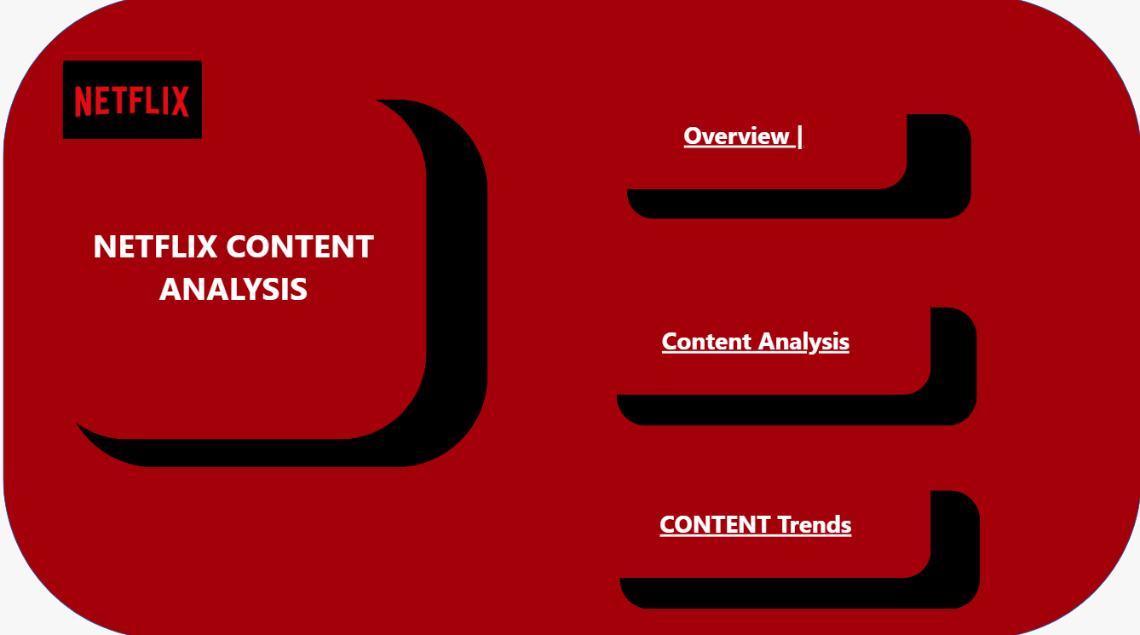
DATA VISUALIZATION — POWER BI
Power BI was used to create an interactive dashboard that presents the main
findings of the Netflix dataset.
Main Filters :
Main KPIs :
  Total Titles
  Total Movies
  Total TV Shows
  Average Release Year
  Country
  Content Type
  Other available dimensions
Main Visualizations :
The dashboard allows users to interact with the data and
explore Netflix content from different perspectives.
  Donut Chart
  Bar Chart
  Line Chart
  Pie Chart
  Column Chart
  Interactive Slicers

Slide 11
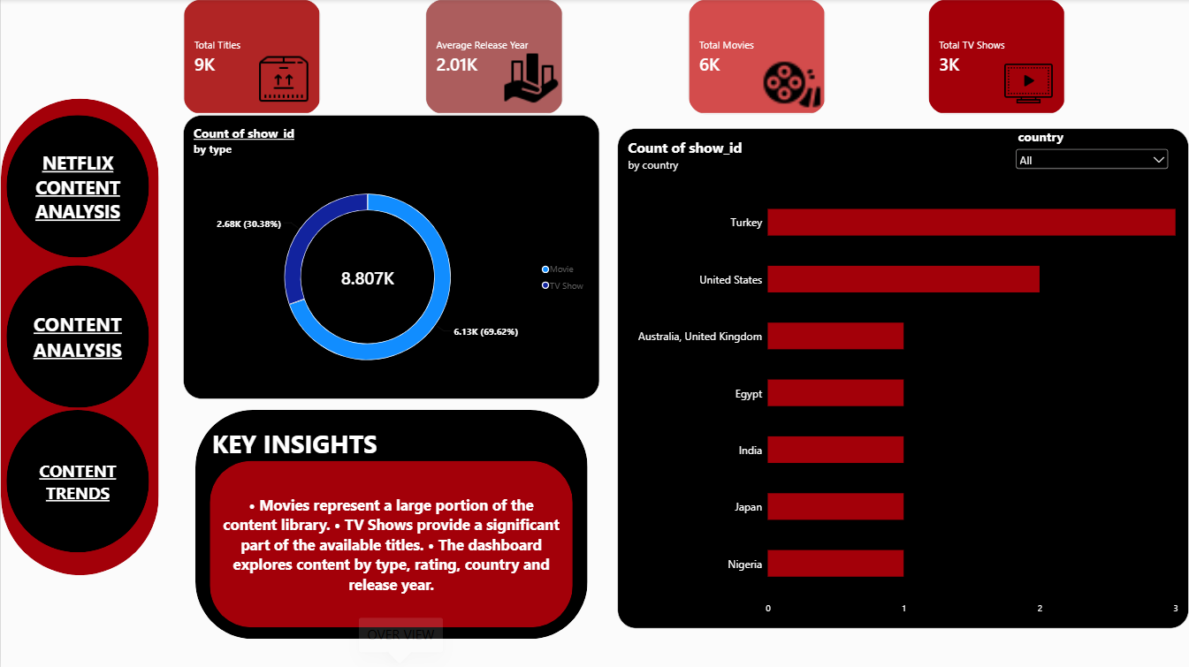
POWER BI — OVERVIEW
The Overview page provides a high-level summary of the Netflix dataset.
It focuses on :
  Total number of titles.
  Total Movies.
  Total TV Shows.
  Average Release Year.
  Distribution of Movies and TV Shows.
  Content distribution by country.
Interactive Feature
The Country Slicer allows users to select a specific country and explore its content distribution.

Slide 12
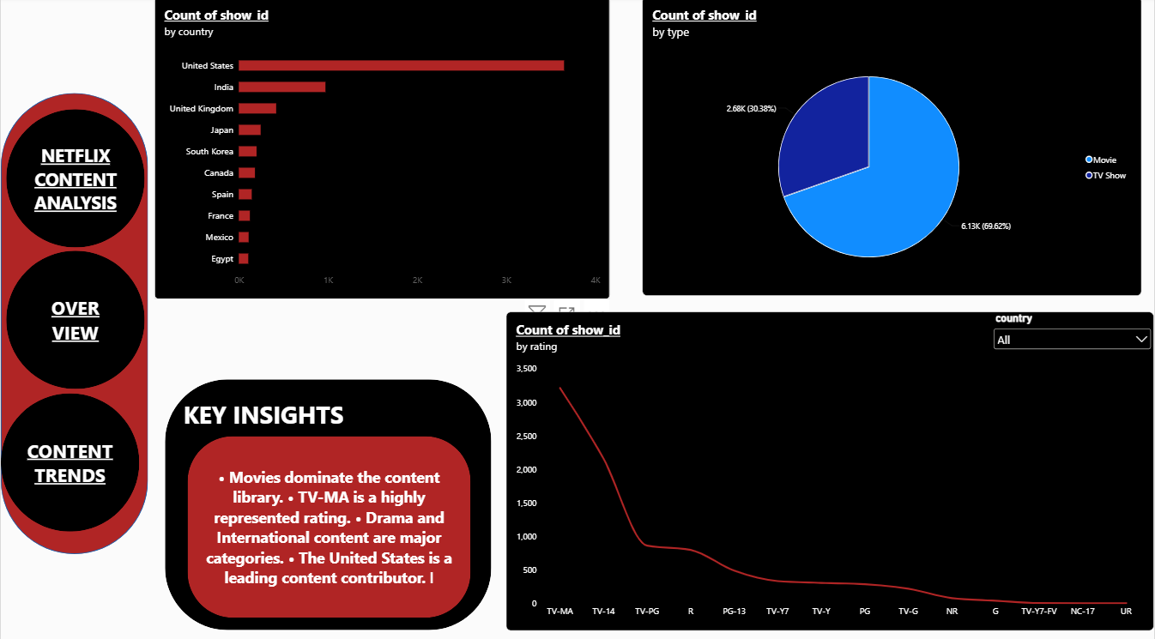
POWER BI — CONTENT ANALYSIS
This page provides a deeper analysis of Netflix content.
Analysis Areas :
  Content by country.
  Content ratings.
  Movies versus TV Shows.
  Distribution across different categories.
Visualizations Used :
  Bar Charts
  Line Charts
  Pie Charts
Interactive filters allow users to focus on specific countries or content types.

Slide 13
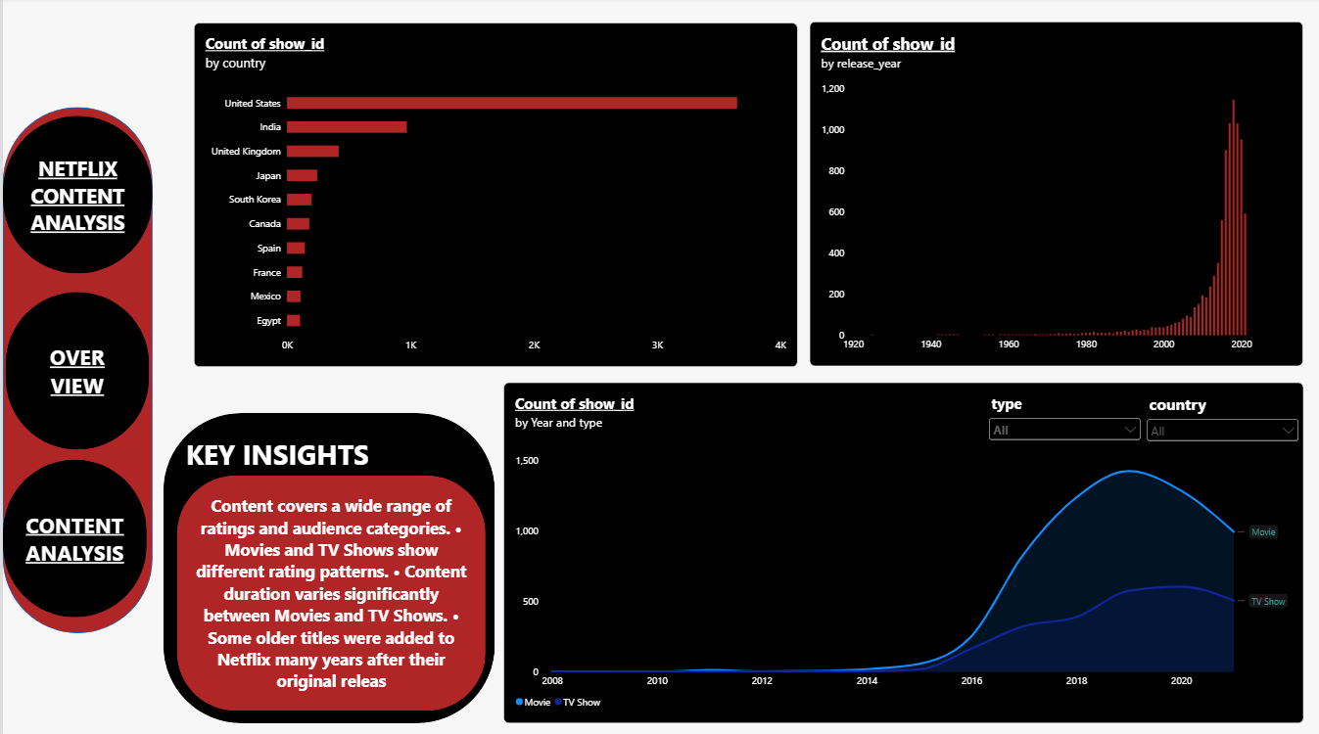
POWER BI — CONTENT TRENDS
The Content Trends page focuses on how Netflix content is distributed across different release years and content types.
Main Analysis :
  Content distribution by release year.
  Movies versus TV Shows over time.
  Trends across different countries.
  Comparison between content types.
Interactive Filters :
  Country
  Content Type
These visualizations help identify changes and
patterns in Netflix content over time.

Slide 14
DATA VISUALIZATION — TABLEAU
Tableau was used as an additional visualization and dashboarding tool.
Main Purposes :
Goal :
  Create interactive visualizations.
  Compare different content categories.
  Identify trends and patterns.
  Analyze relationships between different attributes.
  Present data in a clear and understandable way.
  Use filters to explore the dataset interactively.
To communicate the results of
the analysis through clear and
interactive visualizations.

Slide 15
Key Findings
The analysis of the Netflix dataset revealed several important findings :
  Netflix contains both Movies and TV Shows.
  Content is distributed across a wide range of countries.
  Netflix content covers different ratings and categories.
  The dataset contains content from different release years.
  Movies and TV Shows have different distribution patterns.
  Content distribution varies between countries.
  Release-year analysis helps identify content trends over time.
  Interactive dashboards make these patterns easier to explore and understand.
Combining Excel, SQL, Python, Power BI, and Tableau provides a broader understanding of the dataset.

Slide 16


Data Insights
1. Content Type The dataset contains both Movies and TV Shows, allowing us to compare the two content types.
2. Country Netflix content is distributed across multiple countries, showing the international nature of the platform.
3. Ratings Different content ratings indicate that Netflix provides content for different audience segments.
4. Release Year Analyzing release years helps identify how the content library has developed over time.
5. Content Trends Visualizations help reveal patterns and differences in content distribution across years, countries, and content types.

Slide 17

1. Use Country-Based Analysis
Netflix can use country-level analysis to better understand different markets and identify content opportunities.
Business Recommendations
2. Focus on Audience Segments
Analyzing ratings and content categories can help understand different audience segments and their content preferences.
Based on the analysis, the following recommendations can be considered :
3. Use Content Trends for Future Planning
Historical content trends can support future content acquisition and production decisions.

Slide 18
4. Maintain a Balance Between Movies and TV Shows
Monitoring the distribution of Movies and TV Shows can help support balanced content planning.
Business Recommendations
5. Support Data-Driven Decisions
Data analysis and visualization can be continuously used to support content production, acquisition, and audience targeting.
Based on the analysis, the following recommendations can be considered :
6. Continue Monitoring Content Trends
Regular analysis of new content and changing trends can help Netflix respond to changes in audience interests.

Slide 19
Business Value
The analysis provides value by transforming raw Netflix data into understandable information.
The project can support :
  Better understanding of content distribution.
  Identification of important content trends.
  Comparison between countries.
  Understanding different audience segments.
  More informed content planning.
  Data-driven decision-making.
  Clear communication of insights through interactive dashboards.
The combination of analysis and visualization makes complex information easier to understand and use.

Slide 20

Conclusion
This project demonstrated the complete data analysis process using a Netflix dataset.
We started with raw data and prepared it through data cleaning and organization.
Excel was used for data preparation, SQL was used to query and analyze the data,
and Python was used for further exploration and analysis.
After analyzing the data, Power BI and Tableau were used to transform the results
into interactive visualizations and dashboards. The analysis allowed us to understand Netflix's content distribution, countries, ratings, release years, and content trends.
Finally, the identified insights were transformed into data-driven recommendations
that can support better content and business decisions.
Overall, this project demonstrates how data can be transformed from raw information into meaningful insights that support decision-making.

Slide 21

THANK
YOU

